Slide 1

Fundamentals of Data Science(22CSC59)
BE- CSE-V-Semester
Presented by
S Durga Devi
Assistant Professor
Department of Computer Science and Engineering
Chaitanya Bharathi Institute of Technology
Hyderabad
S. Durga Devi , Dept of CSE, CBIT, Hyderabad

Slide 2

Unit-V
Topics to be covered
Partitioning data using k-means clustering, Hierarchical clustering, DBSCAN clustering, Spectral Clustering: clustering, Evaluating clustering performance, Internal performance evaluation, The Davies-Bouldin index, The silhouette coefficient, External performance evaluation, The Rand score, The Jaccard score, F-Measure or F1-score, The Fowlkes-Mallows score.
Textbook: Avinash Navlani, Armando Fandango, and Ivan Idris, “Python Data Analysis: Perform Data Collection, Data Processing, Wrangling, Visualization, and Model Building Using Python”, 3rd ed. Packt Publishing, 2021.
S. Durga Devi , Dept of CSE, CBIT, Hyderabad
S. Dura Devi ,CSE,CBIT

Slide 3
Clustering algorithms
K- means clustering algorithm
Hierarchical clustering algorithm
DBSCAN clustering
Spectral Clustering
S. Durga Devi , Dept of CSE, CBIT, Hyderabad
S. Dura Devi ,CSE,CBIT

Slide 4
Partitioning algorithm using K means clustering
K- mean is one of the unsupervised machine learning algorithm works on unlabelled data points.
K- means clustering algorithm is used to partition the data points into distinct clusters based on the their similarity.
Similarity is calculated using Euclidean distance / Manhattan.
No of clusters represented by K.
Centroid based algorithm , each cluster associated with centroid.
K- means is fastest and robust algorithm and works well if data points are distinct.
S. Durga Devi , Dept of CSE, CBIT, Hyderabad
S. Dura Devi ,CSE,CBIT

Slide 5
Pseudo code of K- means algorithm
Input: Algorithm K- means(K no of clusters, datapoints)
Select k random data points as the initial centers of clusters(centroids)
Assign each data point to nearest centroid, which will form predefined K clusters.
Calculate the new centroids for newly formed clusters
Repeat step 2and 3 until there is no change in the clusters.
S. Durga Devi , Dept of CSE, CBIT, Hyderabad
S. Dura Devi ,CSE,CBIT

Slide 6
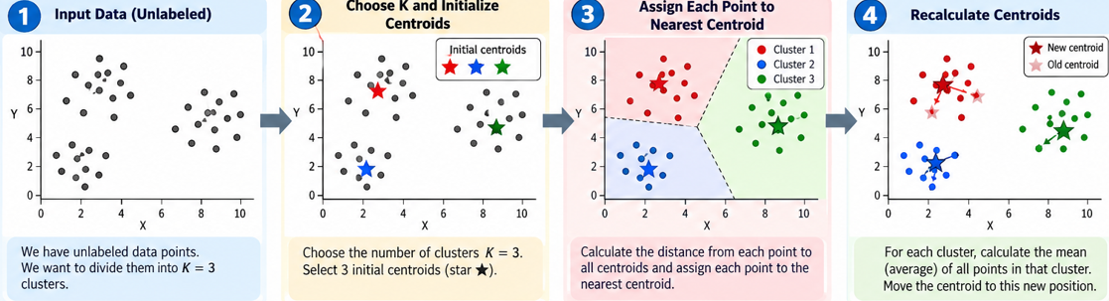
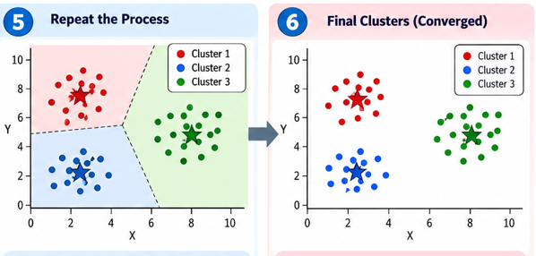
K- means algorithm
Created by AI
S. Durga Devi , Dept of CSE, CBIT, Hyderabad
S. Dura Devi ,CSE,CBIT

Slide 7
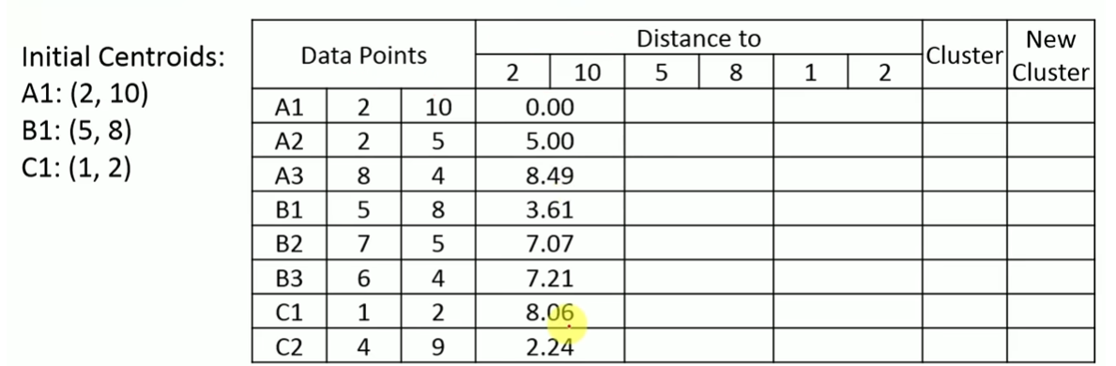

Example on K- means clustering
S. Durga Devi , Dept of CSE, CBIT, Hyderabad
S. Dura Devi ,CSE,CBIT

Slide 8
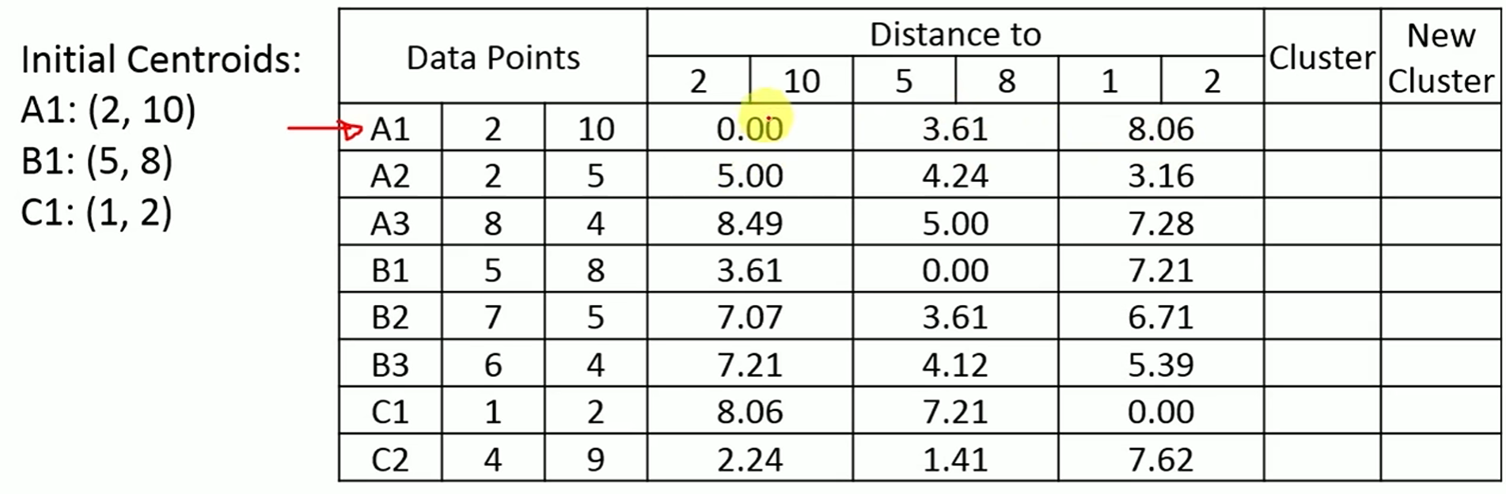
S. Durga Devi , Dept of CSE, CBIT, Hyderabad
S. Dura Devi ,CSE,CBIT

Slide 9
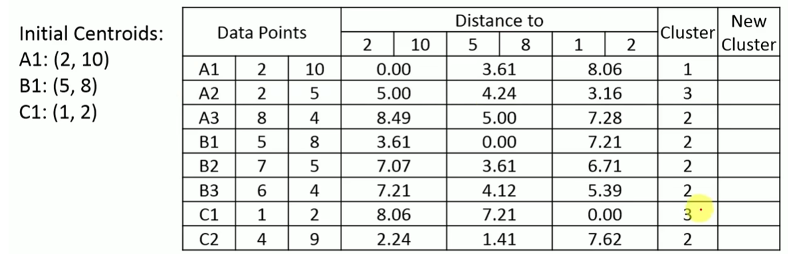
Assign smallest value to the corresponding cluster
Calculate the new centroids
cluster-1- A1(2,10)
Cluster-2-B1(6,6)
Cluster-3-C1(1.5,3.5)
S. Durga Devi , Dept of CSE, CBIT, Hyderabad
S. Dura Devi ,CSE,CBIT

Slide 10
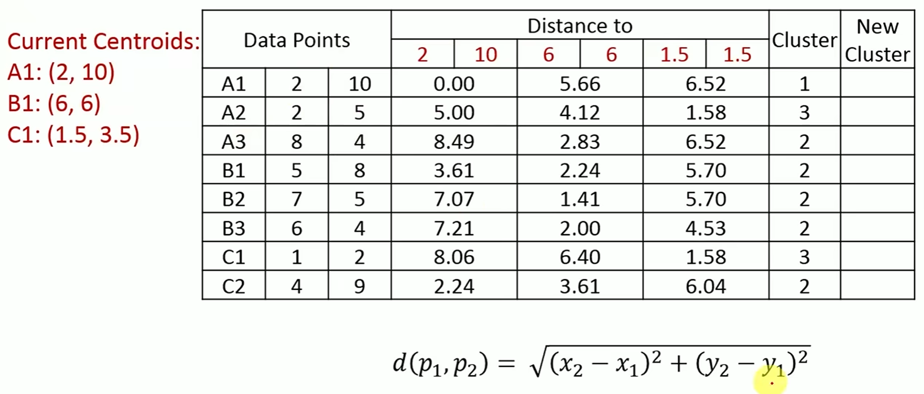
S. Durga Devi , Dept of CSE, CBIT, Hyderabad
S. Dura Devi ,CSE,CBIT

Slide 11
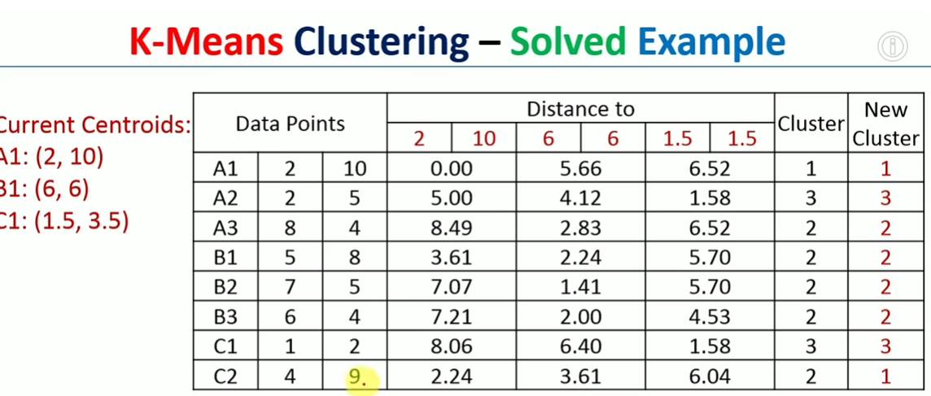
- c2 is moved from cluster 2 to new cluster 1 so again calculate new centroids
S. Durga Devi , Dept of CSE, CBIT, Hyderabad
S. Dura Devi ,CSE,CBIT

Slide 12
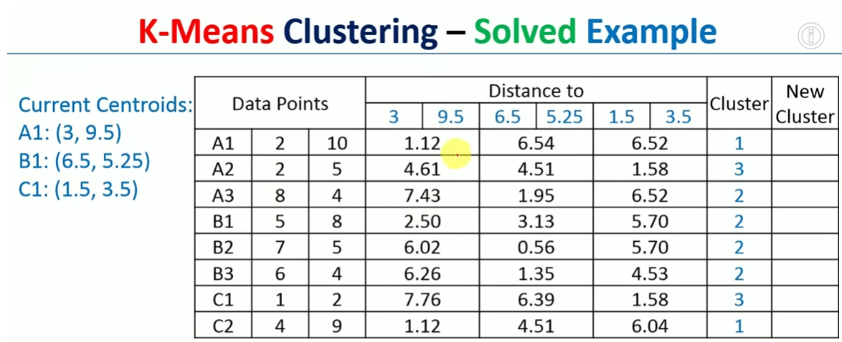
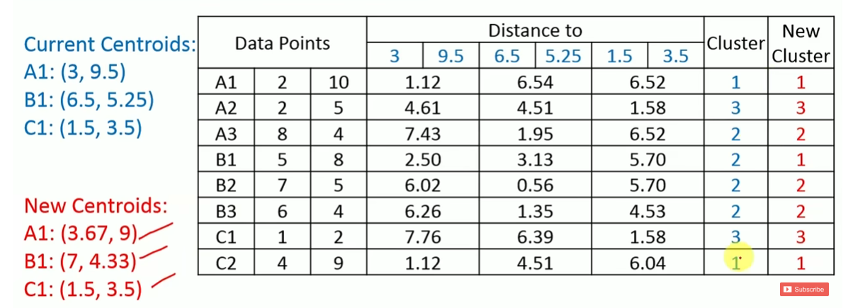
S. Durga Devi , Dept of CSE, CBIT, Hyderabad
S. Dura Devi ,CSE,CBIT

Slide 13
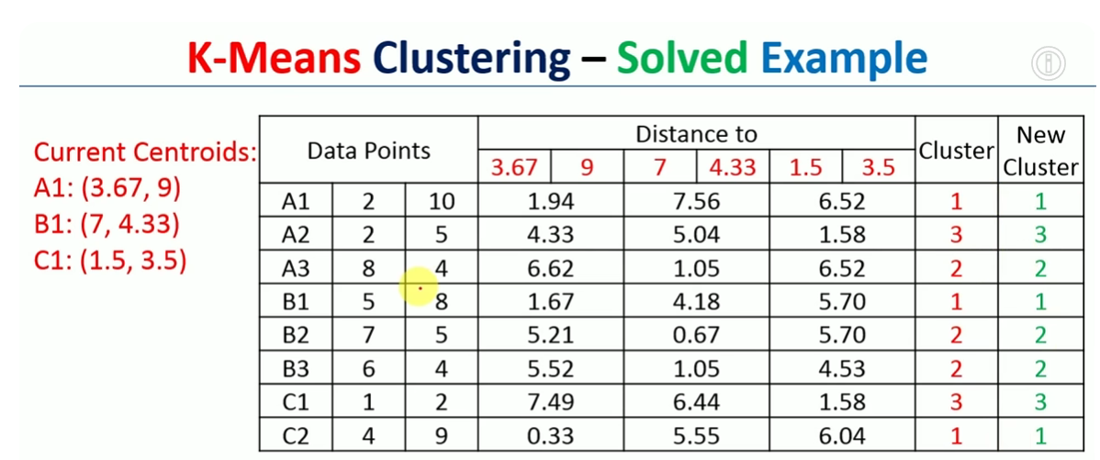
S. Durga Devi , Dept of CSE, CBIT, Hyderabad
S. Dura Devi ,CSE,CBIT

Slide 14
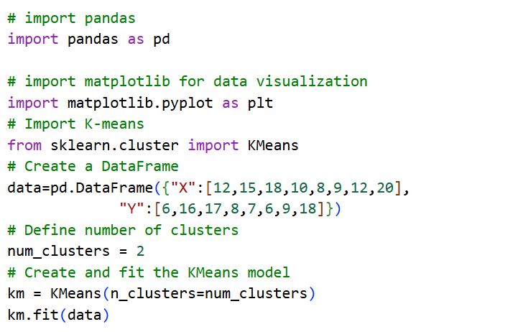
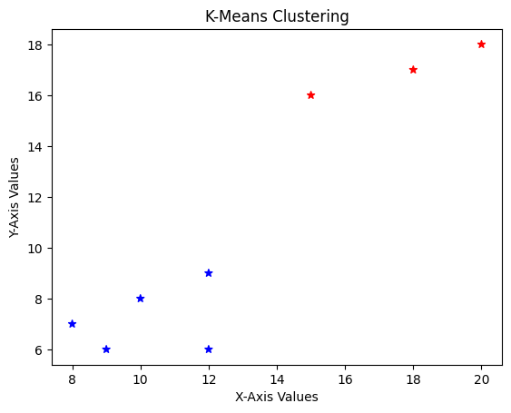
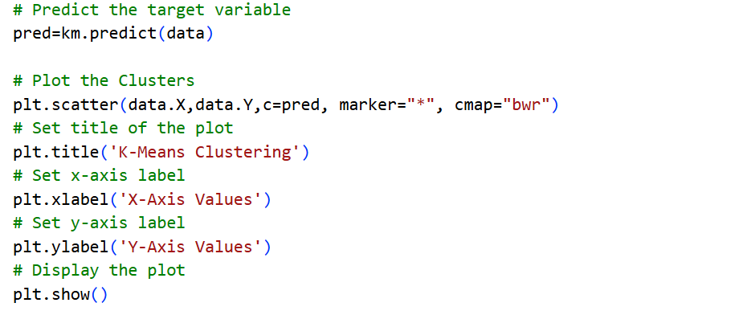
Implementation of K- means clustering
S. Durga Devi , Dept of CSE, CBIT, Hyderabad
S. Dura Devi ,CSE,CBIT

Slide 15
Hierarchical clustering
Hierarchical clustering is an unsupervised machine learning algorithm that groups similar data points into clusters and represents these groups in a tree-like structure called a dendrogram.
Forms the groups based on different levels of a hierarchy using top- down or bottom up strategies.
Pattern recognition and customer segmentation.
Two categories
Agglomerative hierarchical
2. Divisive hierarchical
- Hierarchical clustering builds the multi level hierarchy of clusters by either merging smaller clusters into larger clusters.(agglomerative) and larger clusters are smaller ones(divisive).
S. Durga Devi , Dept of CSE, CBIT, Hyderabad
S. Dura Devi ,CSE,CBIT

Slide 16
Hierarchical clustering
Hierarchical clustering used when we do not know no of clusters in advance.
Example: we have a dataset of customer purchase records. We can group customers with similar purchasing patterns into clusters and identify the potential market segment for the targeted marketing strategies.
Pattern recognition and customer segmentation.
Documentation organization.
S. Durga Devi , Dept of CSE, CBIT, Hyderabad
S. Dura Devi ,CSE,CBIT

Slide 17
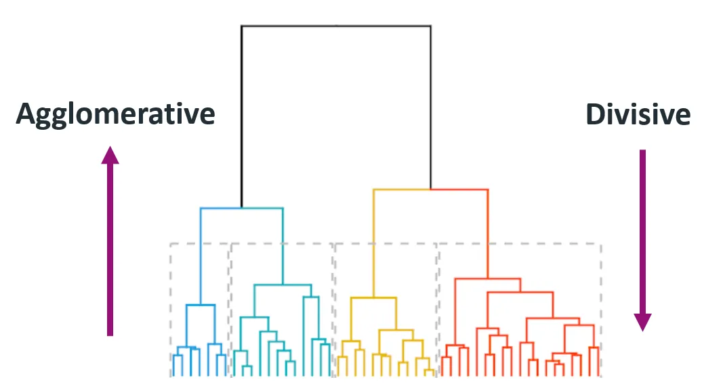
1. Agglomerative( bottom- up)
Starts with every data point is consider as individual cluster.
Iteratively merge the closest pair of clusters until only one cluster formed or until desired no of clusters formed( stopping condition met).
Merges the clusters based on the mindistance and update proximity matrix accordingly.
This method is also called bottom up because starts from the individual data points and build upto top.
S. Durga Devi , Dept of CSE, CBIT, Hyderabad
S. Dura Devi ,CSE,CBIT

Slide 18
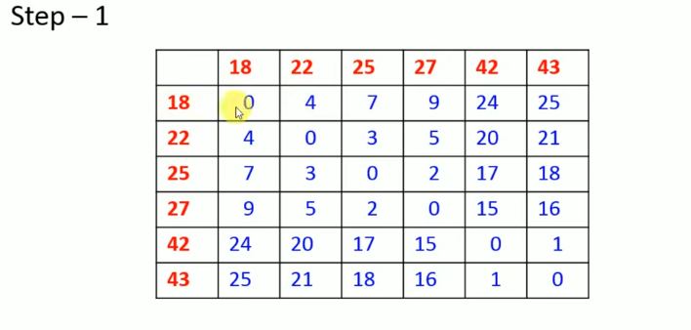
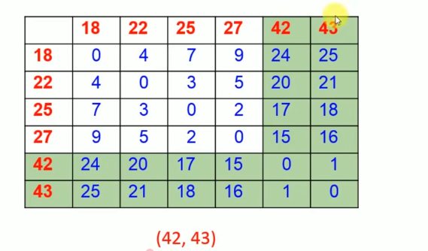
Agglomerative( bottom- up)
S. Durga Devi , Dept of CSE, CBIT, Hyderabad
S. Dura Devi ,CSE,CBIT

Slide 19
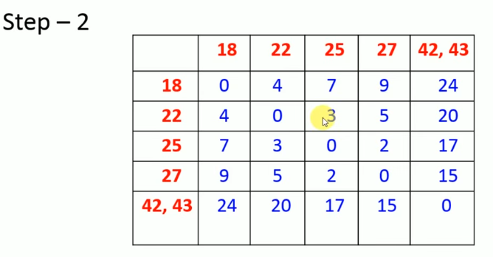
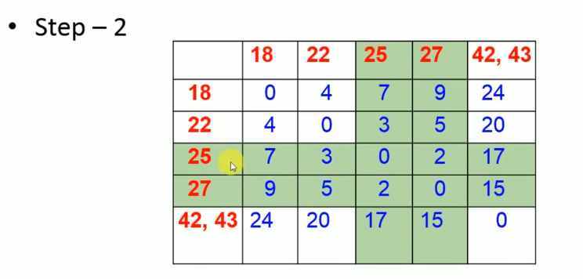
(42,43), (25,27)
S. Durga Devi , Dept of CSE, CBIT, Hyderabad
S. Dura Devi ,CSE,CBIT

Slide 20
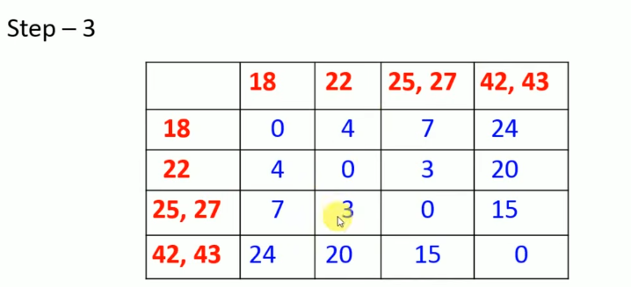
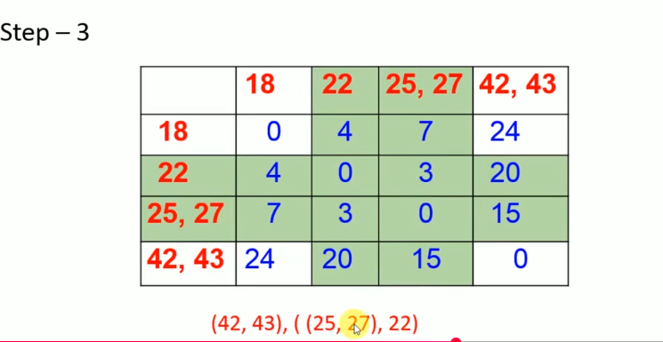
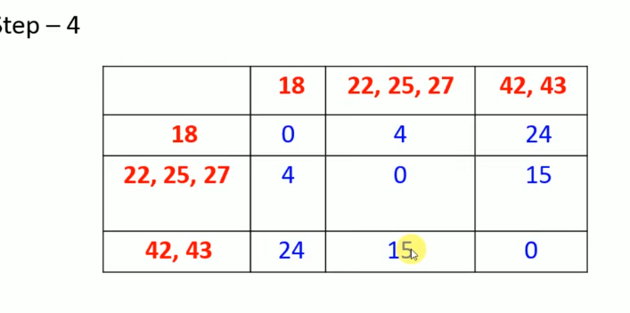
S. Durga Devi , Dept of CSE, CBIT, Hyderabad
S. Dura Devi ,CSE,CBIT

Slide 21
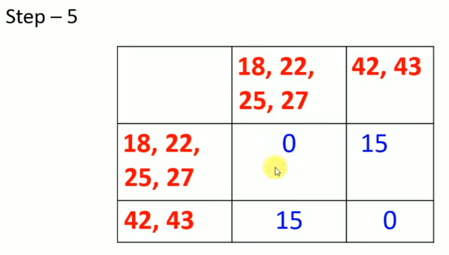
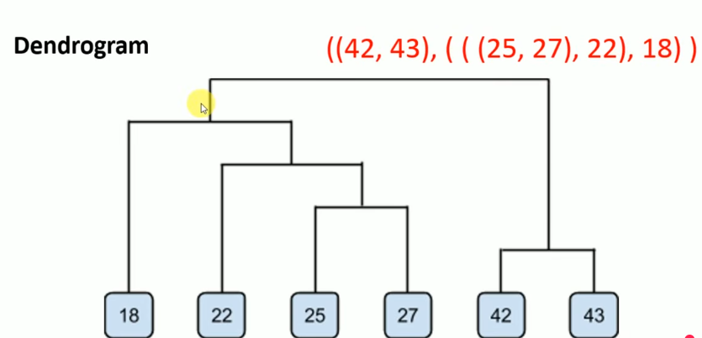
S. Durga Devi , Dept of CSE, CBIT, Hyderabad
S. Dura Devi ,CSE,CBIT

Slide 22
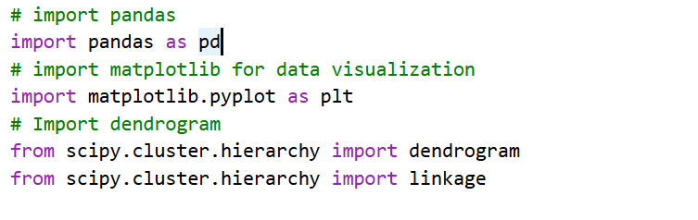
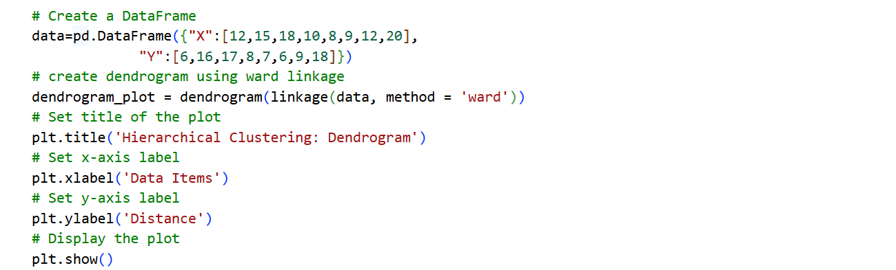
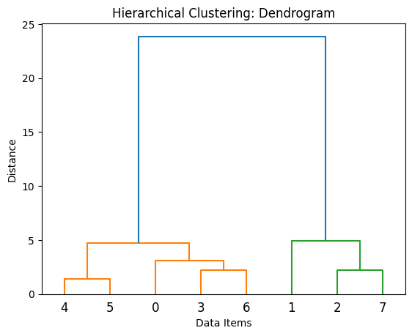
Implementation of Agglomerative
S. Durga Devi , Dept of CSE, CBIT, Hyderabad
S. Dura Devi ,CSE,CBIT

Slide 23
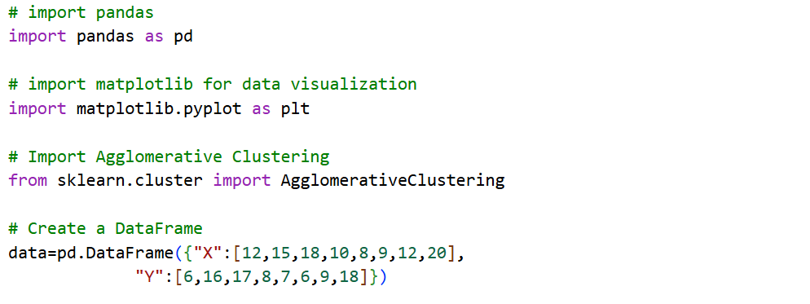
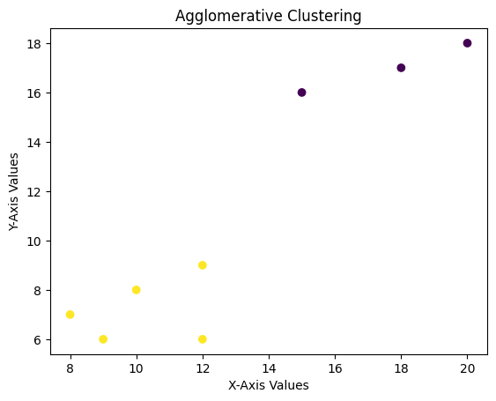
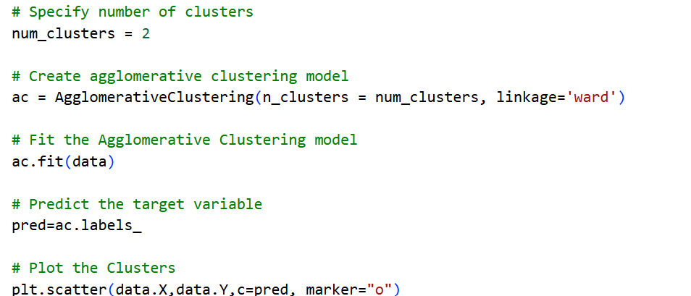
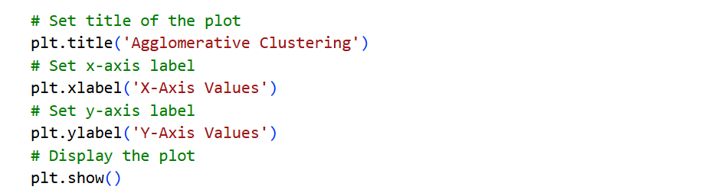
Implementation of Agglomerative in scattered plot
S. Durga Devi , Dept of CSE, CBIT, Hyderabad
S. Dura Devi ,CSE,CBIT

Slide 24
2. Divisive hierarchical clustering( Top- down)
Starts with all the datapoints as single cluster.
Recursively spit them into smaller clusters.
Process continues until each data point in its own individual cluster.
Also called top- down approach, as it starts from the top and decomposed into smaller clusters.
S. Durga Devi , Dept of CSE, CBIT, Hyderabad
S. Dura Devi ,CSE,CBIT

Slide 25
3. DBSCAN clustering
Partitioning clustering algorithms such as k- means and hierarchical clustering methods are sensitive to noise or outliers. And used when clusters can be sphere, circle or convex.
DBSCAN: (Density-Based Spatial Clustering of Applications with Noise) is based on the idea of groups and noise.
DBSCAN groups the data points based on their density( how closely data points are located to one another)
Identifies outliers which does not belong to any other cluster.
No of clusters not needed in advance.
DBSCAN : specifies the Epsilon i.e maximum distance between the data points and minimum number of datapoints within the radius.
S. Durga Devi , Dept of CSE, CBIT, Hyderabad
S. Dura Devi ,CSE,CBIT

Slide 26
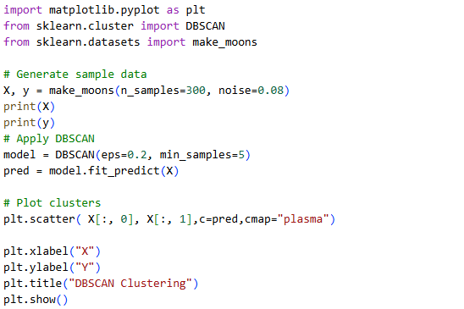
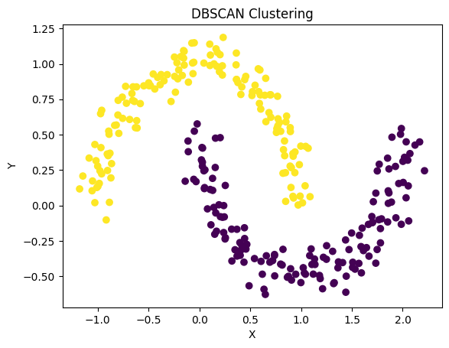
DBSCAN implementation
y is original group labels generated by
make_moon dataset.
S. Durga Devi , Dept of CSE, CBIT, Hyderabad
S. Dura Devi ,CSE,CBIT

Slide 27
Spectral clustering algorithm
Evaluation of clustering algorithms

Slide 28
4. Spectral clustering algorithm
Spectral clustering is another unsupervised machine learning algorithm that groups the data points based on their connectivity and similarity between them.
Graph based machine learning techniques.
Reduces the dimensionality before clustering.
S. Durga Devi , Dept of CSE, CBIT, Hyderabad
S. Dura Devi ,CSE,CBIT

Slide 29


4. Spectral clustering algorithm
Step:1. calculate the similarity matrix to measure how close data points are.
Gaussian similarity function
if similarity is close to 1 : high similarity
close to 0: low similarity
Step-2: Degree matrix: to know how strongly data points are connected.
Step-3: creates a graph (Graph Laplacian matrix(L): L=D-W. Identifies the connected groups.
Calculate Eigenvalues and eigenvectors.- reducing dimensionality
Summation of similarity between the data point i and j
S. Durga Devi , Dept of CSE, CBIT, Hyderabad
S. Dura Devi ,CSE,CBIT

Slide 30
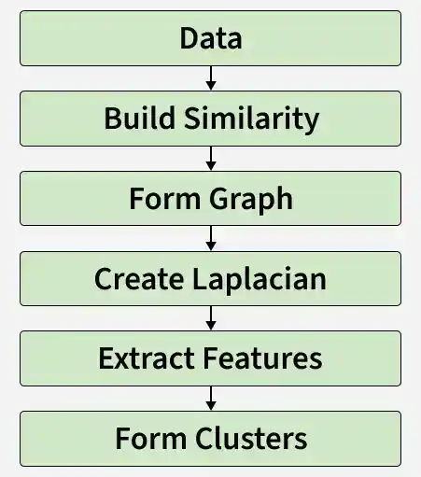
Steps involved in spectral clustering
S. Durga Devi , Dept of CSE, CBIT, Hyderabad
S. Dura Devi ,CSE,CBIT

Slide 31
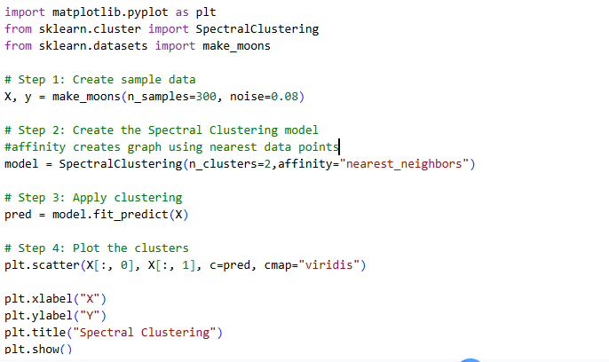
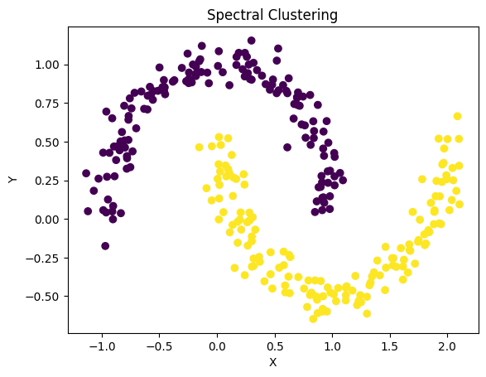
Spectral clustering implementation
S. Durga Devi , Dept of CSE, CBIT, Hyderabad
S. Dura Devi ,CSE,CBIT

Slide 32
Evaluating clustering performance
After building clustering model , measure the quality of the built model means how good is model.
Two categories of evaluating clustering performance
Internal performance evaluation
a) The Davies–Bouldin Index
b) Silhouette Coefficient
External performance evaluation
a) The Randscore
b) Jaccard score
c) F1- score/F – measure
d) Fowlkes–Mallows Score
S. Durga Devi , Dept of CSE, CBIT, Hyderabad
S. Dura Devi ,CSE,CBIT

Slide 33
1. Internal performance evaluation
Clusters are evaluated based on the data points and their assigned cluster labels.
They do not need actual class labels or correct answers to evaluate clusters
Mainly checks two properties
Cohesion: how closely data points are related to each other within the same cluster?
Separation: how far are datapoints apart between different clusters?
Types
Davies–Bouldin Index
Silhouette Coefficient
S. Durga Devi , Dept of CSE, CBIT, Hyderabad
S. Dura Devi ,CSE,CBIT

Slide 34

1. Internal performance evaluation
Davies–Bouldin Index: Evaluates the similarity clusters based on the spreading of data points within cluster and separation from other clusters.
- Ratio between intra cluster distance and inter- cluster distance.
- Lower DBI better clustering result.
Where
n: The number of clusters
cᵢ: The centroid of cluster i
σᵢ: The intra-cluster distance or average distance of all cluster items from the centroid cᵢ
σj: The intra-cluster distance or average distance of all cluster items from the centroid cj
d(cᵢ, cⱼ): The inter-cluster distance between two cluster centroids cᵢ and cⱼ
S. Durga Devi , Dept of CSE, CBIT, Hyderabad
S. Dura Devi ,CSE,CBIT

Slide 35

2. Silhouette Coefficient:
The Silhouette Coefficient measures how well a data point fits into its own cluster compared with the nearest other cluster.
High score Silhouette score indicates better clustering results.
aᵢ: The average distance of the iᵗʰ data point to other points within the cluster.
bᵢ: The average distance of the iᵗʰ data point to other cluster points.
Silhouette coefficient ranges -1 to 1. higher values is better clustering model.
S. Durga Devi , Dept of CSE, CBIT, Hyderabad
S. Dura Devi ,CSE,CBIT

Slide 36

2. External performance evaluation
External evaluation metrics measure how well the clusters discovered by an algorithm match the actual known class labels.
Requires ground truth information.
Example:
we have four students. Their actual categories are already known and K- means produces the following clusters
S. Durga Devi , Dept of CSE, CBIT, Hyderabad
S. Dura Devi ,CSE,CBIT

Slide 37

2. External performance evaluation
1. The Rand Score:
Compares every pair of data points and check whether predicted cluster matching with the actual class label.
Consider both correct grouping together and correct separation
Where
TP: True Positive: pair is together in both actual and predicted
TN: True Negative: pair is separate in actual and predicted
FP: False Positive: pair is together in predicted cluster but separated in actual
FN: False Negative: Pari is separated in predicted cluster but together in actual.
S. Durga Devi , Dept of CSE, CBIT, Hyderabad
S. Dura Devi ,CSE,CBIT

Slide 38
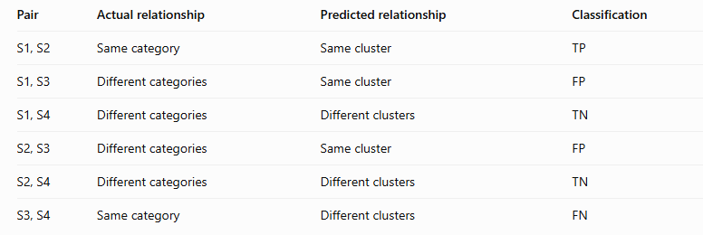

1. The Rand Score
The model achieved a Rand Score of 0.5, meaning that 50% of all pairs of data points
were correctly grouped as either belonging to the same cluster or belonging to different clusters.”
S. Durga Devi , Dept of CSE, CBIT, Hyderabad
S. Dura Devi ,CSE,CBIT

Slide 39
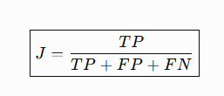
2. Jaccard Score:
Measures similarity between data points.
Focuses only on grouping data points together correctly
Ranges from 0 to 1
S. Durga Devi , Dept of CSE, CBIT, Hyderabad
S. Dura Devi ,CSE,CBIT

Slide 40
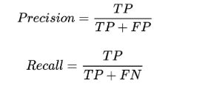

3. F1- Score
- Measures the precision and robustness of clustering algorithm
The F1- score is harmonic mean of precision and recall.
Precision: how many positive predicted cases are actually positive.
Recall: how many actual positive cases the model predicted correctly.
F1- score must be high
S. Durga Devi , Dept of CSE, CBIT, Hyderabad
S. Dura Devi ,CSE,CBIT

Slide 41

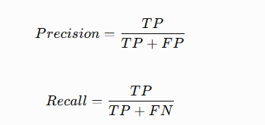
4. Fowlkes–Mallows Score
Calculates the geometric mean of Precision and Recall, using pairs of data points.
Higher score is better
Where
S. Durga Devi , Dept of CSE, CBIT, Hyderabad
S. Dura Devi ,CSE,CBIT

Slide 42
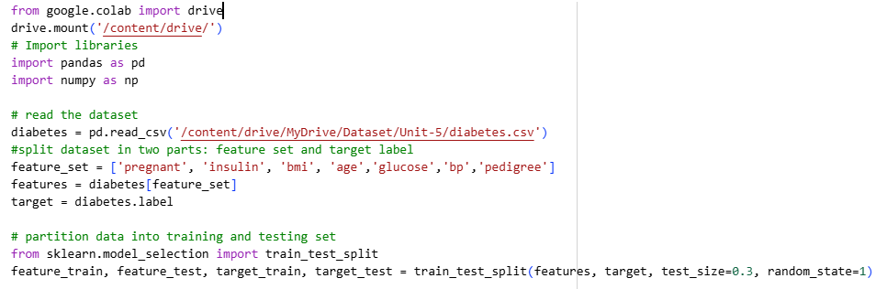
Example
S. Durga Devi , Dept of CSE, CBIT, Hyderabad
S. Dura Devi ,CSE,CBIT

Slide 43
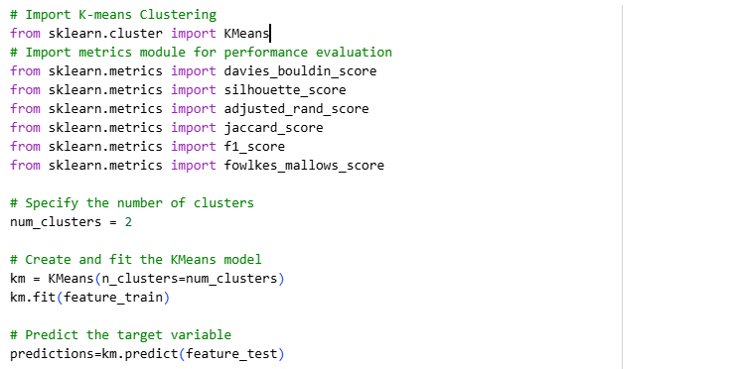
S. Durga Devi , Dept of CSE, CBIT, Hyderabad
S. Dura Devi ,CSE,CBIT

Slide 44
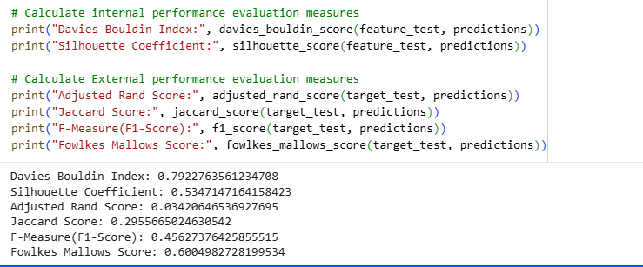
S. Durga Devi , Dept of CSE, CBIT, Hyderabad
S. Dura Devi ,CSE,CBIT

Slide 45
references
Case studies from textbook-1
Page nos 321
https://github.com/PacktPublishing/Python-Data-Analysis-Third-Edition/tree/master/Chapter11
https://data-flair.training/blogs/clustering-in-machine-learning/
https://techvidvan.com/machine-learning-courses/?campaign=btah&ref=1
https://data-flair.training/blogs/types-of-machine-learning-algorithms/
https://data-flair.training/blogs/r-data-science-project-customer-segmentation/ - case study
https://data-flair.training/blogs/data-science-r-movie-recommendation-system/ - case study
https://www.datacamp.com/tutorial/hierarchical-clustering
S. Durga Devi , Dept of CSE, CBIT, Hyderabad
S. Dura Devi ,CSE,CBIT

